Slide 1
Data Engineering and Machine Learning on OpenShift
Sherard Griffin
Senior Manager
AI CoE
Václav Pavlin
Principal Software Engineer
AI CoE
Peter MacKinnon
Principal Software Engineer
AI CoE

Slide 2
Agenda
Introductions
How Red Hat Sees AI
Why AI and Machine Learning on OpenShift?
AI as a Service
Data Engineering on OpenShift
Running GPU Workloads
AI/ML Software Partners
Lab Logistics and Setup
Presenter (System Admin persona) - Installing Open Data Hub (ODH) via ODH operator
Attendees (Data Engineers and Project Owners)
Instantiating ODH in their OpenShift projects
JupyterHub, Kafka, Spark, Ceph, Prometheus, Grafana, Seldon Inferencing
Lab - Analytics and Data Science (Data scientists persona)
Spark: Using Spark to access and manipulate data from two data sources
TensorFlow: Using TF to create models and serving models using Seldon
Creating Jobs on OpenShift

Slide 3
Introductions
PHOTO
PHOTO
PHOTO
Name:
Role/team:
Where you’re from:
Name:
Role/team:
Where you’re from:
Name:
Role/team:
Where you’re from:

Slide 4
How Red Hat Sees AI

Slide 5
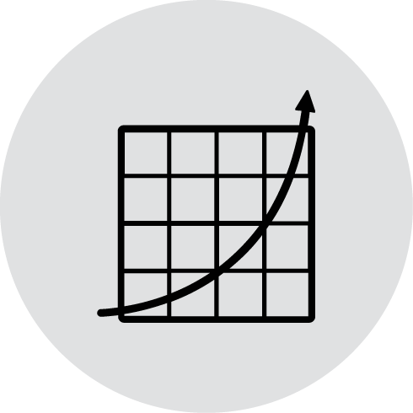

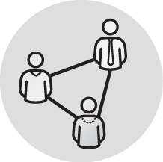

AI as a Workload Represents a workload requirement for our platforms across the hybrid cloud.
AI Accelerates Open Source Development Applicable to Red Hat’s existing core business in order to increase Open Source development and production efficiency.
AI Enhances RH Products & Services Valuable to our customers as specific services and product capabilities, providing an Intelligent Platform experience.
AI Enables Customers to build Intelligent Apps using Red Hat products as well as our broader partner ecosystem.
010110
101010
Data as the Foundation

Slide 6
AI at Red Hat
Hybrid Cloud AI Enablement Strategy
1
Hybrid Cloud Platform (AI as workload)
2
AI Transformation
Core Enablement
Ecosystems
Internal
Products & Services
Customer
HW Enablement
ISV
Improve quality & scale of existing products & services via AI
Create direct incremental customer value through AI features
Enable customers to build their own AI
Storage Integration
Infrastructure
Stack Optimization
Community
Open Data Hub
3
Data as the Foundation

Slide 7
Why AI and Machine Learning on OpenShift?

Slide 8





Machine Learning Pipeline
Business
Objectives
Data
Acquisition & Preparation
ML Modelling
(Selection, Training, Testing)
ML Model Deployment in App. Dev. Process
Data
Intelligent applications
to achieve
business outcomes
Data Engineer
Data Scientists
Business
Leadership
App Developer
Business
Leadership
IT Operations

Slide 9
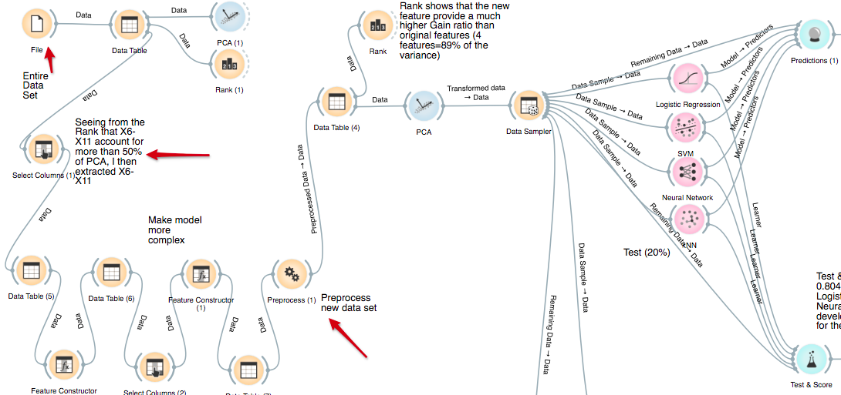


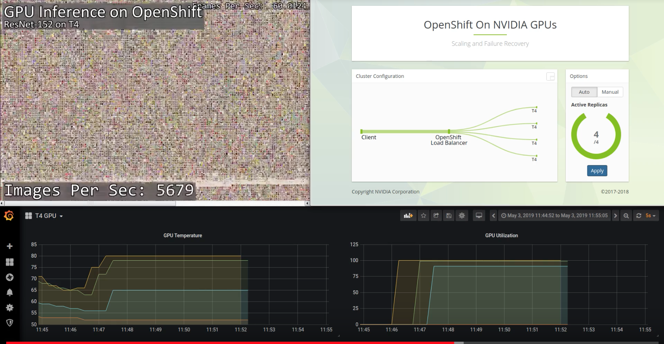
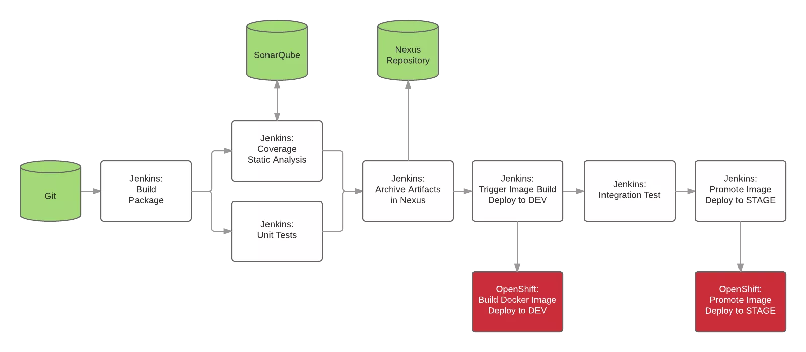
What Does a Data Scientist Want?
As a Data Scientist, I want a “self-service cloud like” experience for my Machine Learning projects, where I can access a rich set of modelling frameworks, data, and computational resources, share and collaborate with colleagues, and deliver my work into production with speed, agility and repeatability to drive business value!
Self service portal to select ML frameworks, data access
Perform ML Modelling
Inferencing w/ hardware acceleration
ML model deployment in app dev

Slide 10

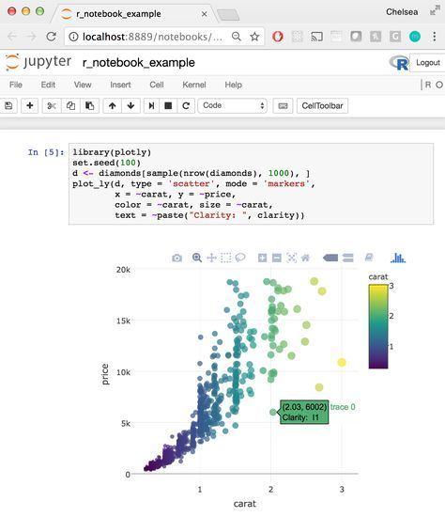
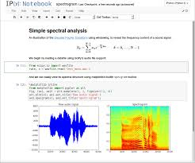
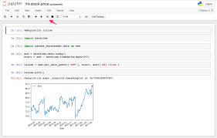

Current Situation and Challenges
Team(s) of Data Scientists and Developers
Sharing and collaboration, if any, is difficult, manual, error prone and take time
Access to limited non-shared resources means modeling takes long times or can’t achieve desired accuracy
Delivering into models into production is a challenge
DATA SCIENTIST
DATA SCIENTIST
DATA SCIENTIST

Slide 11
Why Containers & Kubernetes in Hybrid Cloud for AI/ML workloads?
Red Hat products & services help solve additional challenges
Automation, CI/CD drive collaboration
Boost productivity
Data access, prep, & governance
Apps lifecycle management & operations
Portability & flexibility for ML powered apps
Develop/deploy ML apps across data center, edge, and public clouds
Offer ML-as-a-service
3
2
Agility across the ML pipeline
Automated install and provisioning
Autoscaling
GPU acceleration, scaling, security, uptime
1
Notes:
Boost productivity - data scientists, developers

Slide 12



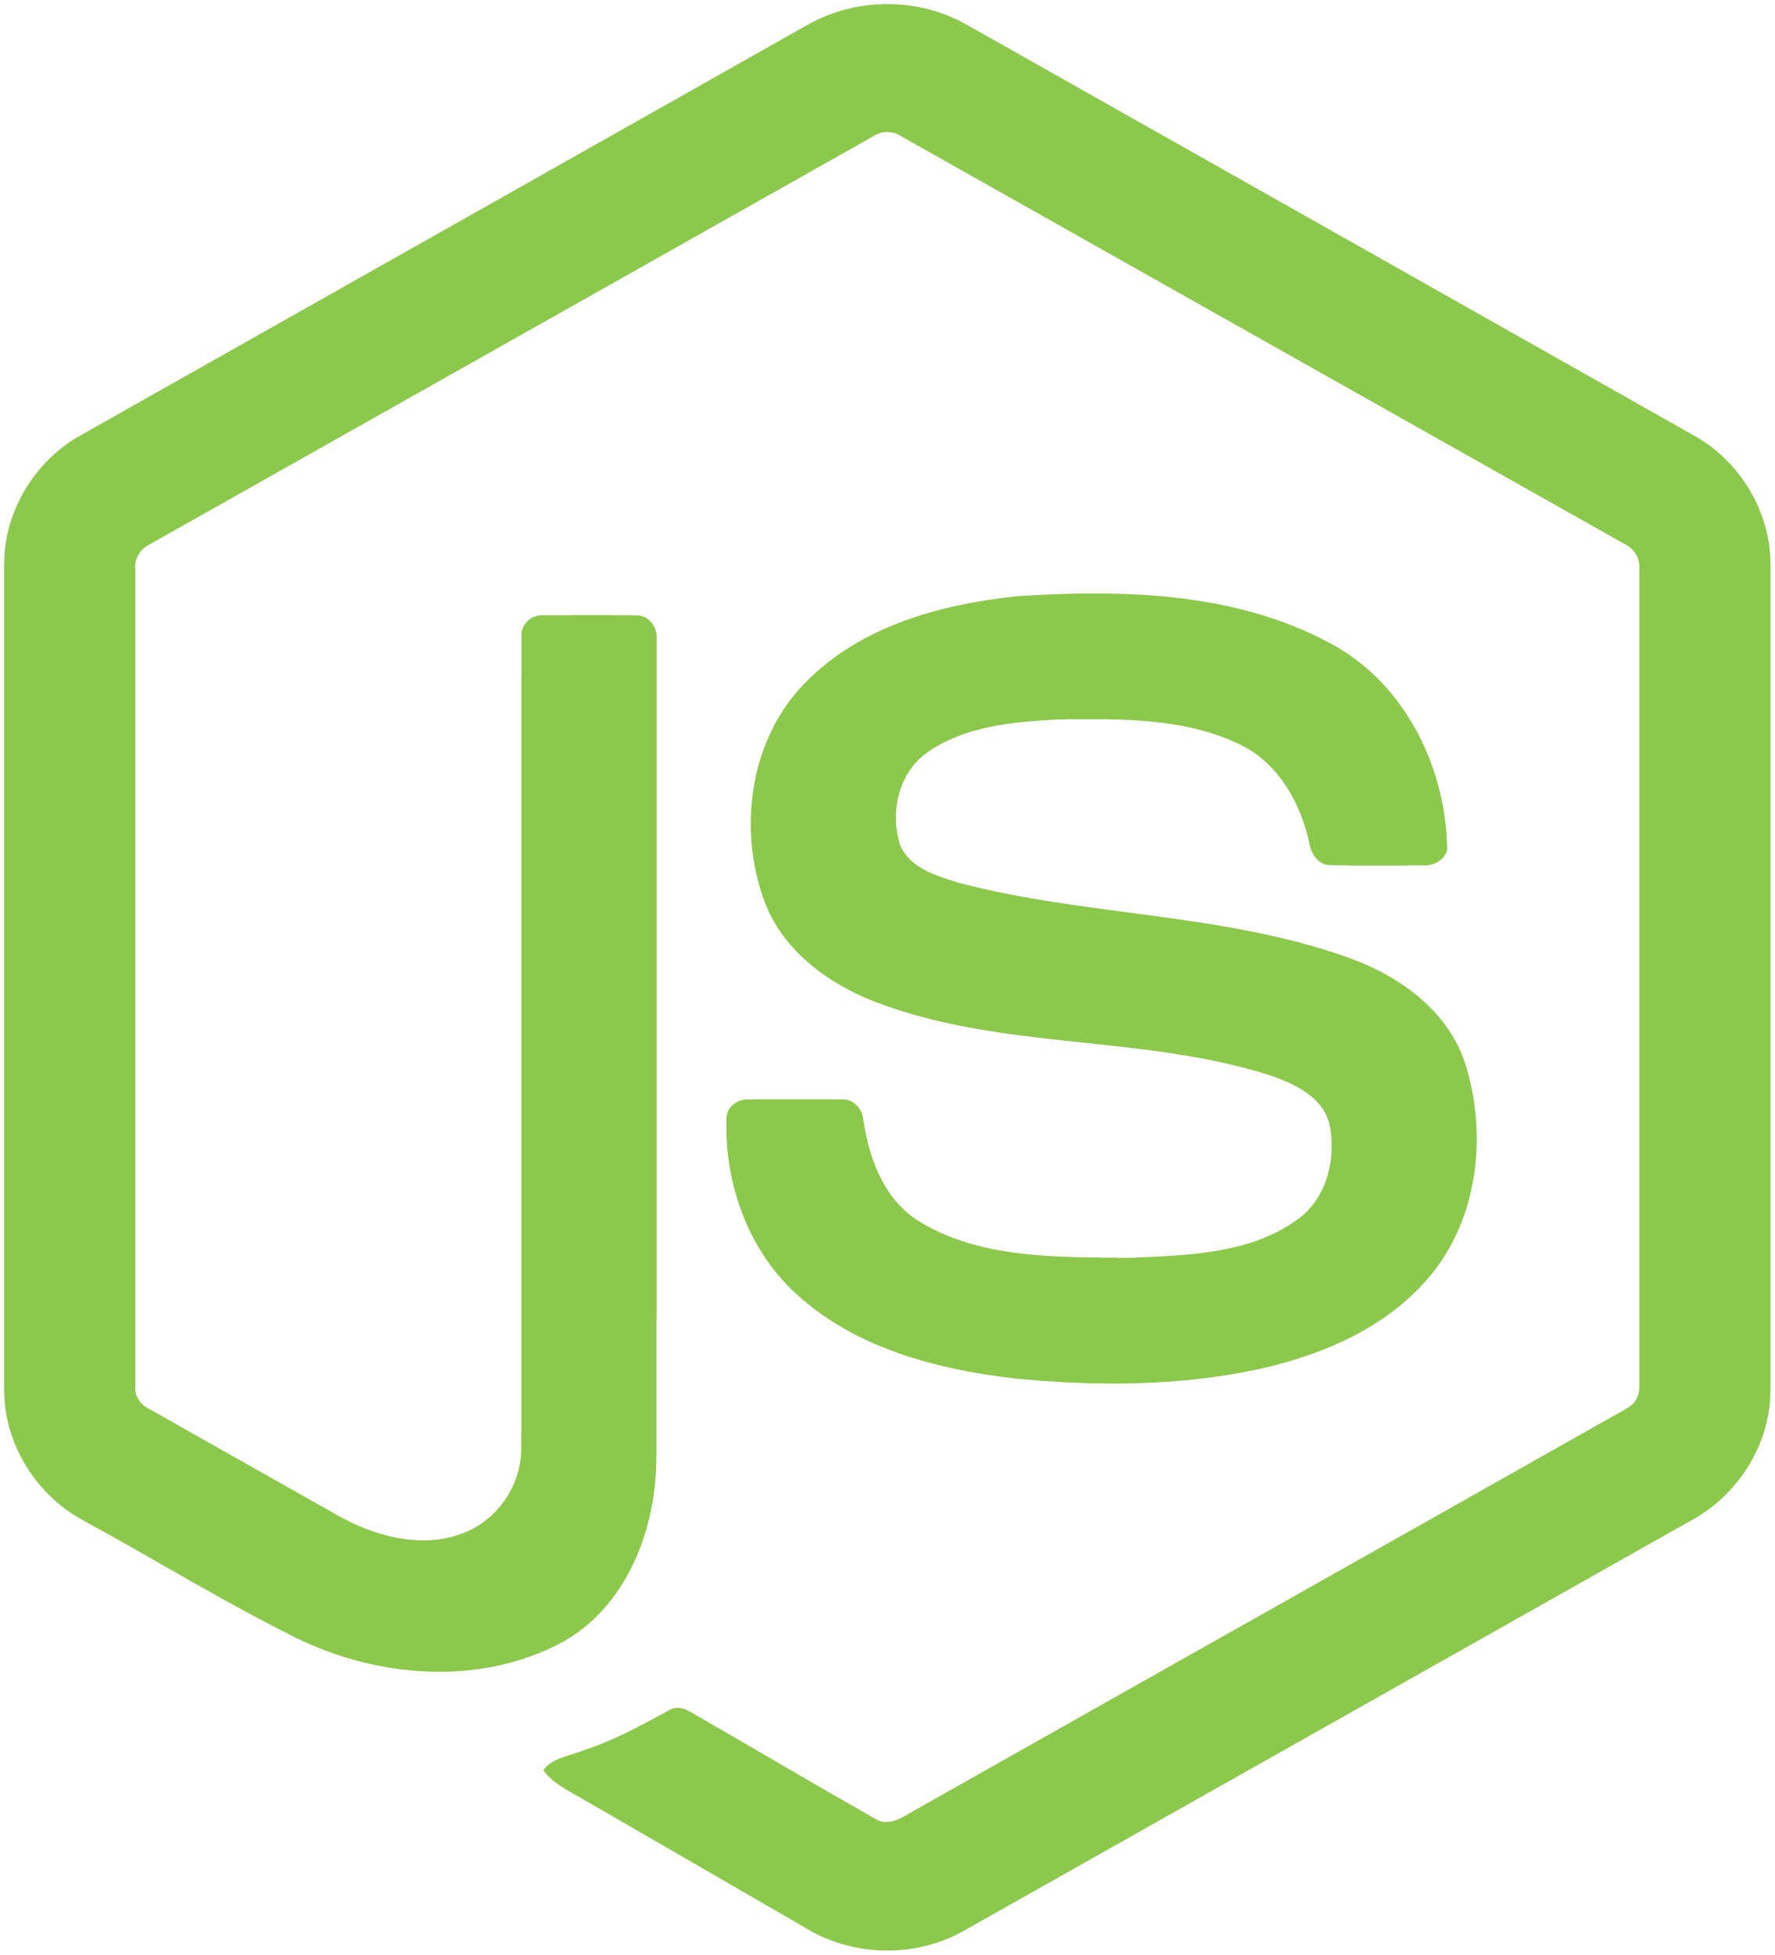










Why OpenShift And Cloud Platforms for ML Workloads?
Best of SDLC
ML services, load balanced and scaled
SERVICE LAYER
RED HAT
ENTERPRISE LINUX
NODE
NODE
NODE
PERSISTENT
STORAGE
SCM
(GIT)
MASTER
C
C
API/AUTHENTICATION
c
ML microservices scheduled and orchestrated on shared resources
CI/CD
C
C
C
DATA STORE
DATA SCIENTIST
RHEL
RHEL
RHEL
SCHEDULER
NODE
NODE
NODE
REGISTRY
EXISTING AUTOMATION TOOLSETS
HEALTH/SCALING
C
C
C
C
C
RHEL
RHEL
RHEL
ML deployed across clouds, data center, and edge
ML in Production
PHYSICAL
VIRTUAL
PRIVATE
PUBLIC
HYBRID

Slide 13





AI/ML on OpenShift Momentum is Strong
Healthcare and public sector
Automotive
Financial
Oil and gas
Public cloud alternative for research
RBC Bank
Containerized Apache Spark
Democratize data science for oil and gas exploration
Connected Drive & Autonomous Driving
Back-end AI Platform
Discover Financial Services
Data-driven diagnosis
Data-driven diagnosis
Ministry of Defence (Israel)
Jupyter notebooks as a service
Notes:
HCA Healthcare’s leadership identified sepsis rates as a key challenge that data could help solve. Sepsis, a condition where the body’s immune system has an overwhelming response to infection, is responsible for 270,000 deaths per year in the U.S. alone.1 The group sought to use predictive data analysis to establish a standardized, digital approach to sepsis detection. “To support our care providers with modern tools like machine learning and cloud computing, we needed a platform that is flexible, scalable, and fast,” said Dr. Edmund Jackson, chief data scientist at HCA Healthcare.

Slide 14
AI as a Service

Slide 15
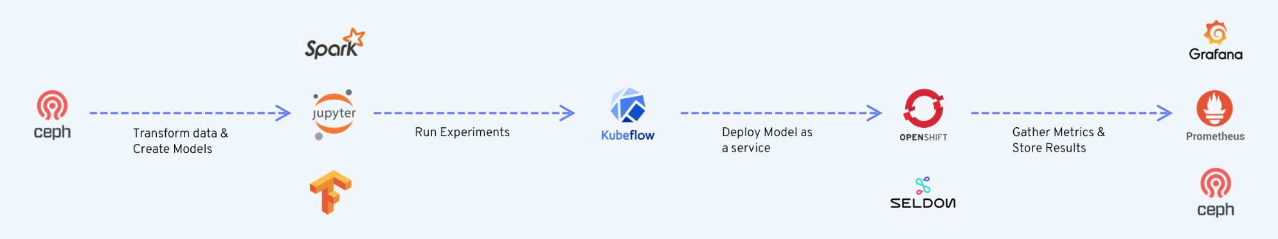
The Open Data Hub Project
OpenDataHub.io
Meta-operator that integrates best open source AI/ML/Data projects
Blueprint architecture for AI/ML on OpenShift
Red Hat’s internal Data Science and AI platform
Open Data Hub Architecture: https://opendatahub.io/docs/architecture.html
Data
Acquisition & Preparation
ML Model
Selection, Training, Testing
ML Model Deployment in App. Dev. Process
Notes:
Operate the core platform as part of the MOC, provide easy access to Research and Open Source communities with full transparency and modularity.
Deploy Data Hub in the MOC to position Red Hat as relevant to AI by serving as:
The ‘Github’ for data and AI for the Open Source community
A platform for sharing AI services
A public proof point to validate Red Hat’s AI strategy

Slide 16







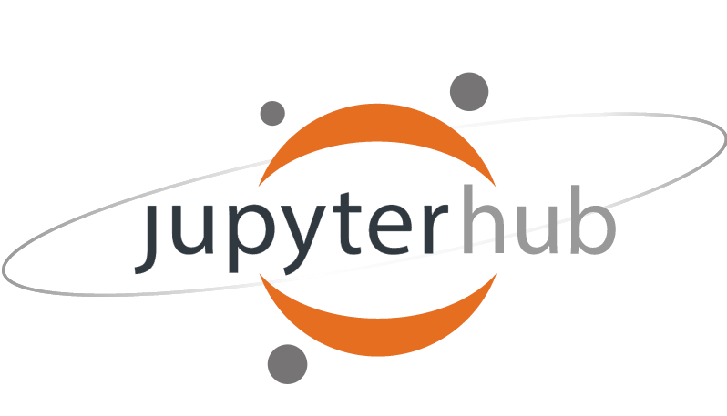



Open Data Hub v0.4 Operator
Available Now at OpenDataHub.io
Monitoring and alerting toolkit
Used to diagnose problems
Analytics platform for all metrics
Query, visualize and alert on metrics
Deploying machine learning models as micro-services
Full model lifecycle management
Unified analytics engine
Large-scale data access
Multi-user Jupyter
Used for data science and research
Distributed Object Store
S3 Interface
Distributed event streaming
Pub/Sub Messaging
Container-native workflow engine
Declaratively deploy ML pipelines and models

Slide 17
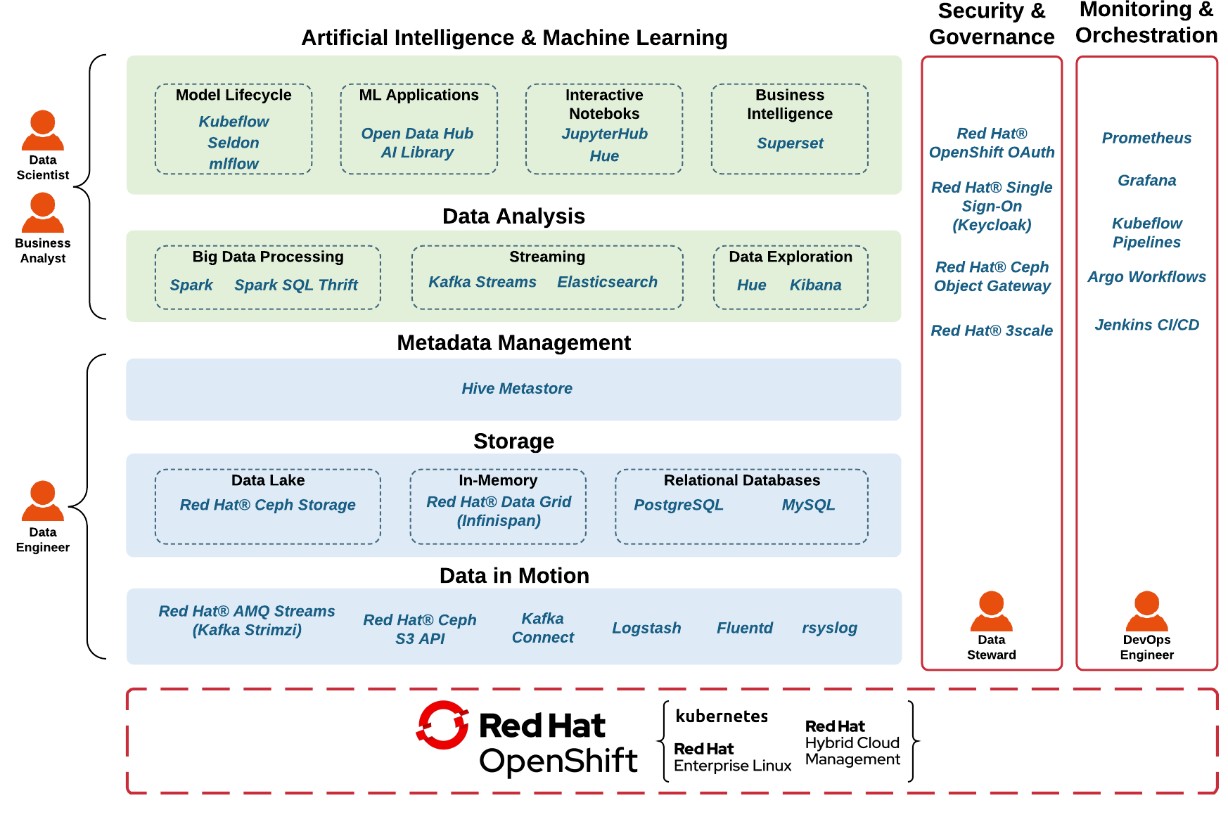
Open Data Hub Blueprint

Slide 18
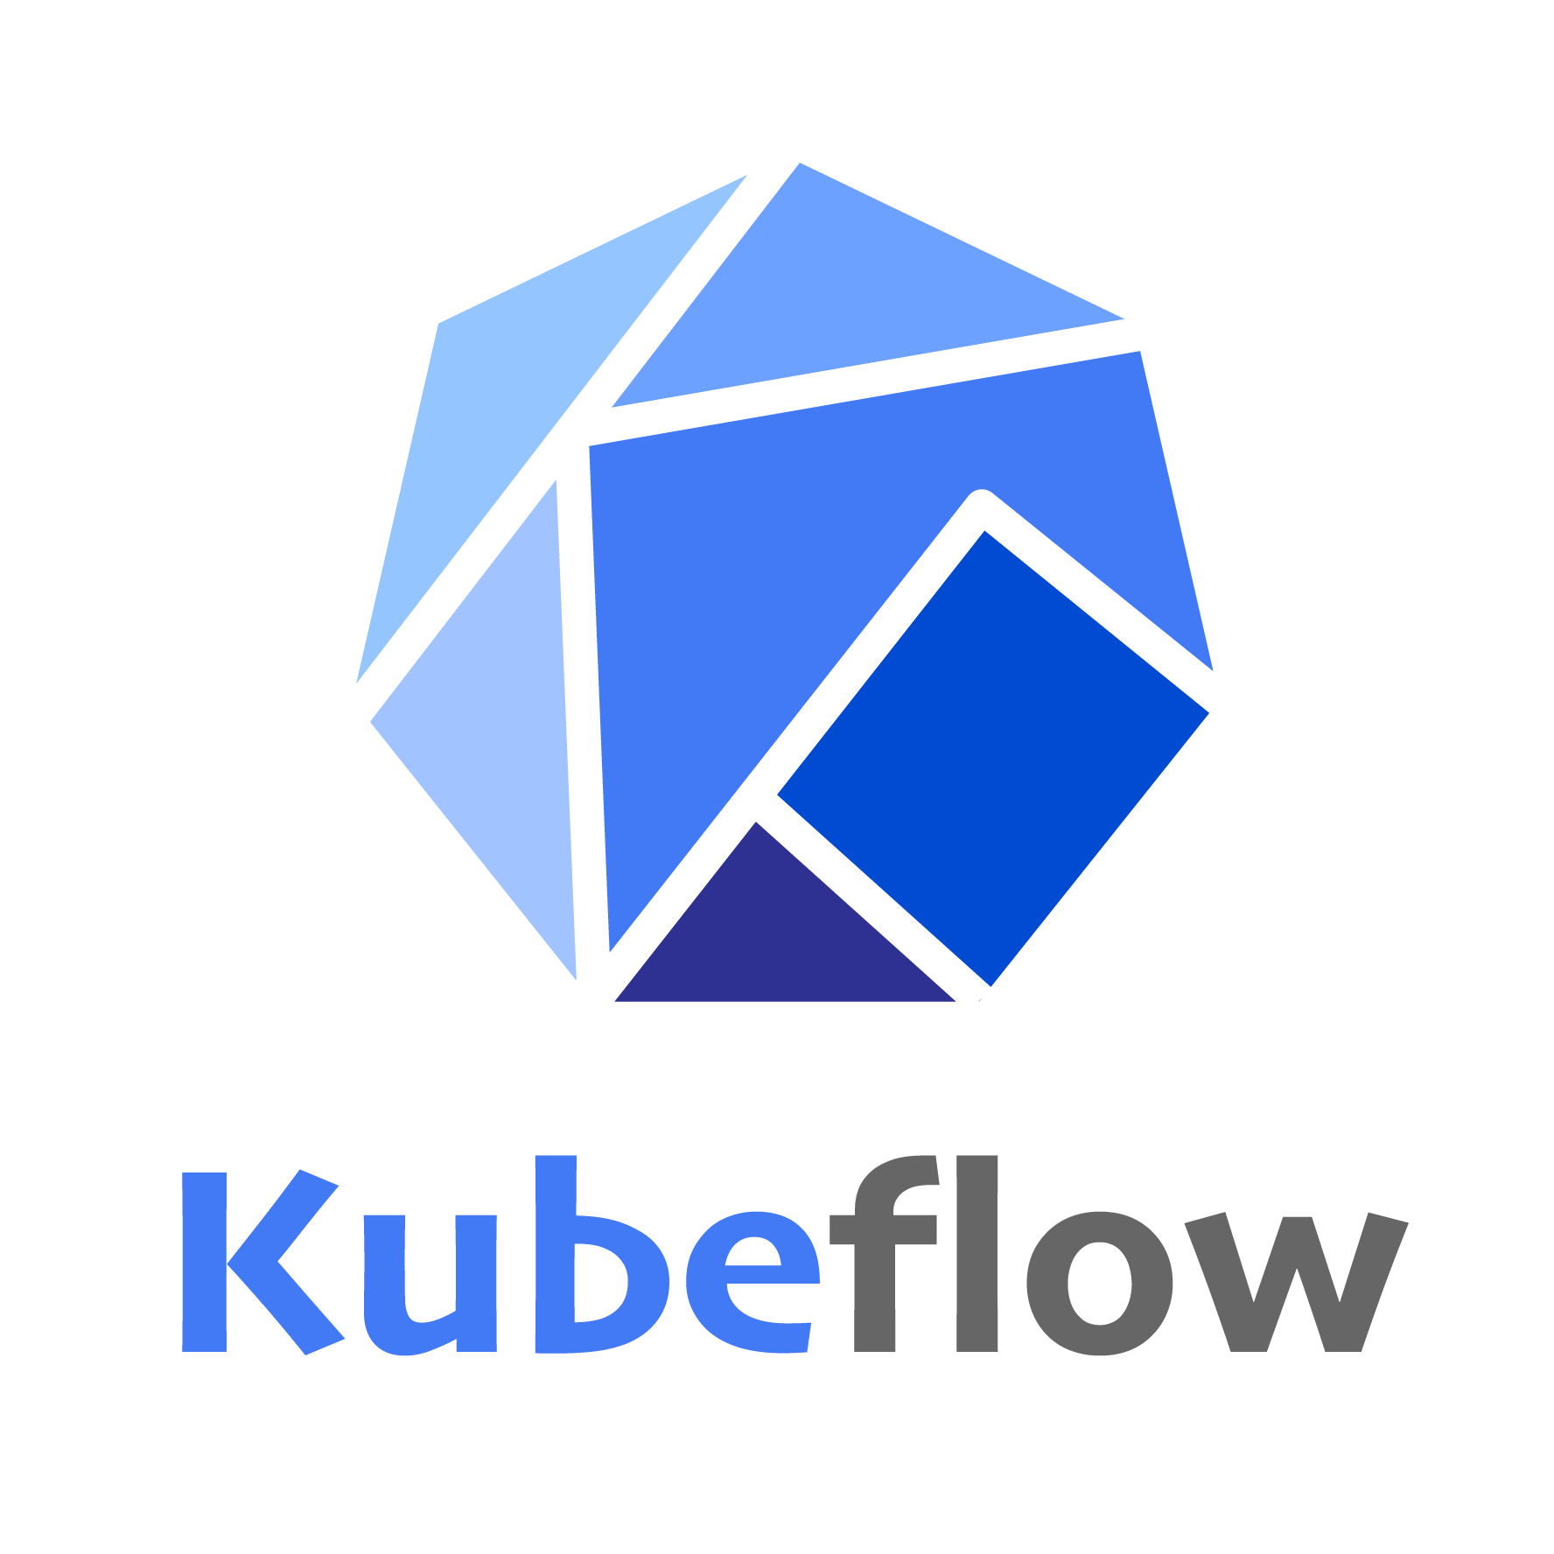






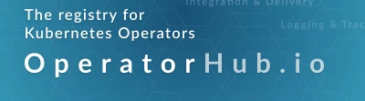
Upstream/Community Projects in the AI/ML Space
Tensorflow
NVIDIA NGC
GPU optimized
and curated
ML toolkit and lifecycle
Kube
Others
ML-as-a-service platform based on OpenShift, Ceph, Kafka, JupyterHub, Spark,
Home for k8s community to share operators for various apps/tools
Notes:
Red Hat Open Hybrid Cloud as THE PLATFORM for customers AI/ML initiatives

Slide 19
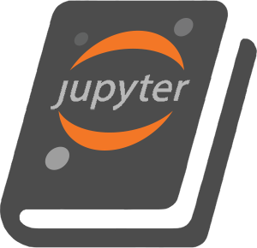

Jupyter Notebooks as a Service
Role based access
control, quotas
DATA SCIENTIST
DATA SCIENTIST
DATA SCIENTIST
DATA SCIENTIST
DATA SCIENTIST
DATA SCIENTIST
Self service
notebooks
Resource isolation
(cpu, mem, gpu, nvme)
Data and network
isolation
Project Foo
Project Bar
Shared resource
pools
Red Hat
OpenShift Container Platform

Slide 20
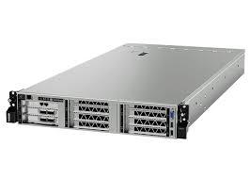
Pooling and Sharing Resources with JupyterHub on OpenShift
Jupyter Hub
DATA SCIENTIST
DATA SCIENTIST
DATA SCIENTIST
DATA SCIENTIST
DATA SCIENTIST
DATA SCIENTIST

Slide 21
Jupyter as a Service Multi-tenancy
Identity and Role Based Access
Project Isolation (Data, Networks)
Sharing of Resources with Protection
Resource Isolation
Resource Quotas
Priority and Preemption
DATA SCIENTIST
DATA SCIENTIST
Jupyter
Hub
Project Echo
Project Tango
CPUs, GPUs, Memory, NVMe
All this is possible with OpenShift 3.11 and OpenShift 4.1 (and later)

Slide 22
Data Engineering on OpenShift

Slide 23






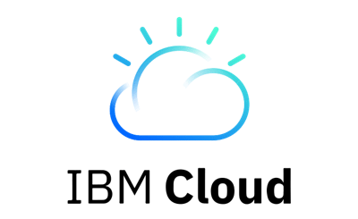



Data Pipelines
Enterprise App
Data Ingest
Discovery
Data
Processing
Analytics
ML
Training
ML
Inference
CI/CD Pipelines
RDBMS
OPEN DATA HUB
AI PLATFORM POWERED BY OPEN SOURCE
Multi cloud gateway
Red Hat
OpenShift Container Storage
Ceph
Red Hat
OpenShift Container Platform
Red Hat
OpenStack Platform
Baremetal
Persona Key
Infra
Engineer
Data Engineer
Data Scientist
App
Developer
Notes:
Infrastructure engineers provide a platform for building platforms (k8s) on underlying infrastructure (cloud or on-prem)
Data engineers build a data platform on that platform, ODH is an example data platform built with open source components, using the operator framework
Data engineers and data scientists use that platform for data discovery, processing, analytics, and ml training/inference

Slide 24
Data Pipelines
Multiple data sources (apps, sensors, devices, satellites, infrastructure)
Multiple data pipelines exist in every organization
Data pipelines should continually evolve to improve
Discoverability
Cleanliness
Scalability
Machine Learning should be used to derive value from data pipelines in ways that would not otherwise possible with analytics alone

Slide 25
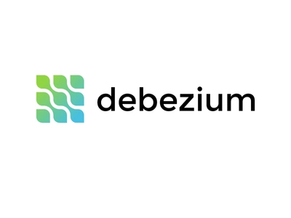


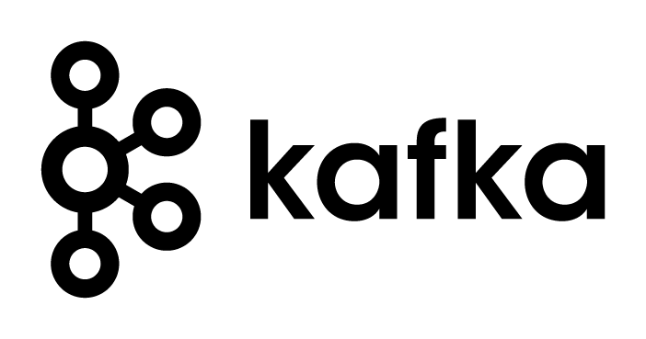

Data Ingest
External
ETL
Streaming Ingest
External
Streaming Ingest
Data Ingest
Discovery
Data
Processing
Analytics
ML
Training
ML
Inference
Data Warehouse
OPEN DATA HUB
AI PLATFORM POWERED BY OPEN SOURCE
Object Data Lake
Red Hat
OpenShift Container Storage
Persistent Volumes
Red Hat
OpenShift Container Platform
External
Direct Ingest
Direct Ingest
Direct Ingest
Notes:
Apps can write unstructured or semi-structured data directly to object based data lake
Data warehouse is a tidy subset of the object based data lake
Machine learning acts on data in object based data lake in-situ

Slide 26




Data Discovery
Notebooks
Data Ingest
Discovery
Data
Processing
Analytics
ML
Training
ML
Inference
Data Warehouse
OPEN DATA HUB
AI PLATFORM POWERED BY OPEN SOURCE
Object Data Lake
Red Hat
OpenShift Container Storage
Persistent Volumes
Red Hat
OpenShift Container Platform
External
Data Discovery
External
Data Discovery
Notes:
Apps can write unstructured or semi-structured data directly to object based data lake
Data warehouse is a tidy subset of the object based data lake
Machine learning acts on data in object based data lake in-situ

Slide 27
Data Processing
Notebooks
Data Ingest
Discovery
Data
Processing
Analytics
ML
Training
ML
Inference
Data Warehouse
OPEN DATA HUB
AI PLATFORM POWERED BY OPEN SOURCE
Object Data Lake
Red Hat
OpenShift Container Storage
Persistent Volumes
Red Hat
OpenShift Container Platform
Data Processing
Data Processing
Notes:
Apps can write unstructured or semi-structured data directly to object based data lake
Data warehouse is a tidy subset of the object based data lake
Machine learning acts on data in object based data lake in-situ

Slide 28
Analytics
Notebooks
Data Ingest
Discovery
Data
Processing
Analytics
ML
Training
ML
Inference
Data Warehouse
OPEN DATA HUB
AI PLATFORM POWERED BY OPEN SOURCE
Object Data Lake
Red Hat
OpenShift Container Storage
Persistent Volumes
Red Hat
OpenShift Container Platform
Data
Discovery
Data
Discovery
Notes:
Apps can write unstructured or semi-structured data directly to object based data lake
Data warehouse is a tidy subset of the object based data lake
Machine learning acts on data in object based data lake in-situ

Slide 29

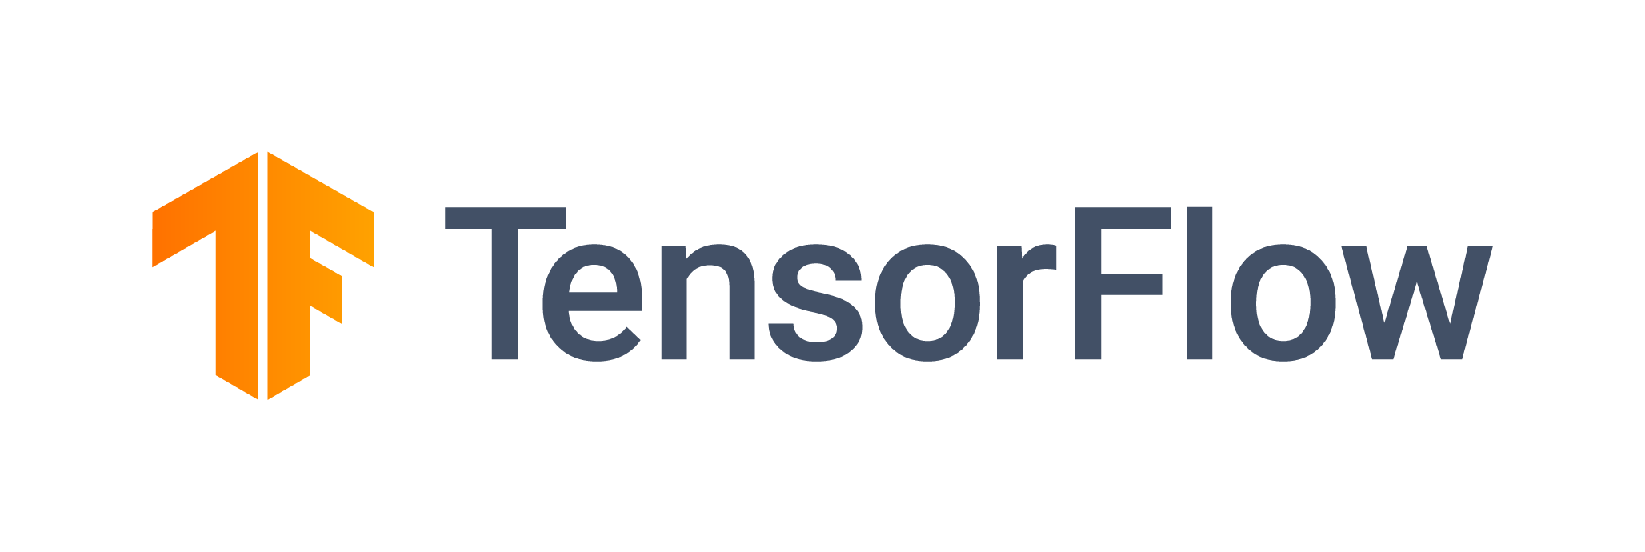
ML Training
Notebooks
Data Ingest
Discovery
Data
Processing
Analytics
ML
Training
ML
Inference
Data Warehouse
OPEN DATA HUB
AI PLATFORM POWERED BY OPEN SOURCE
Object Data Lake
Red Hat
OpenShift Container Storage
Persistent Volumes
Red Hat
OpenShift Container Platform
Notes:
Apps can write unstructured or semi-structured data directly to object based data lake
Data warehouse is a tidy subset of the object based data lake
Machine learning acts on data in object based data lake in-situ

Slide 30
ML Inference
Data Ingest
Discovery
Data
Processing
Analytics
ML
Training
ML
Inference
Data Warehouse
OPEN DATA HUB
AI PLATFORM POWERED BY OPEN SOURCE
Object Data Lake
Red Hat
OpenShift Container Storage
Persistent Volumes
Red Hat
OpenShift Container Platform
Models
Notes:
Apps can write unstructured or semi-structured data directly to object based data lake
Data warehouse is a tidy subset of the object based data lake
Machine learning acts on data in object based data lake in-situ

Slide 31
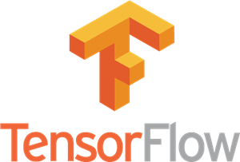
Mapping Data Pipeline Activities
Notebooks
Broker Cluster
Streaming Cluster
Batch Cluster
Model Serving
Discovery
Analytics
Data Ingest
Data Processing
Analytics
Data Ingest
Data Processing
Analytics
Data Processing
Analytics
ML Inference
Metastore
Consumer Cluster
Ad-hoc Cluster
Interactive Query
Training, Serving
Discovery
Data Ingest
Data Processing
Discovery
Data Processing
Analytics
Discovery
Data Processing
Analytics
ML Training
ML Inference

Slide 32
Data Access with OpenShift Container Storage
Persistent Volumes
Object Storage
Fast and dynamic provisioning
Regional durability
RWO, RWX
Provided by OCS 3 and OCS 4
Common API across hybrid cloud (S3)
Provided by OCS 4
Scale Massively
Billions of objects
Petabytes of data

Slide 33
Mapping OpenShift Container Storage Services
Notebooks
Broker Cluster
Streaming Cluster
Batch Cluster
Model Serving
Discovery
RWX PVs
RWO PVs
Checkpoint to S3
Sink to S3
RWX PVs
Metastore
Consumer Cluster
Ad-hoc Cluster
Interactive Query
Training, Serving
Discovery
RWO PVs
Sink to S3
Source / Sink to S3
Source / Sink to S3
Source from S3

Slide 34
Running GPU Workloads

Slide 35

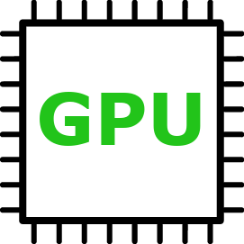
Enablement of GPUs as a service on OpenShift
2
K8s device plugin for GPU
GPU Operator builds the GPU enablement stack
CRIO GPU runtime plugin
CUDA driver (or container)
GPU node_exporter for Prometheus
1
Label: GPU
NFD Operator recognizes GPUs and labels the nodes
Managing updates and lifecycle with operators. Automating the experience with operators.
GPU supported in OpenShift 3.11 and OpenShift 4.1 with RHEL7 only on GPU nodes; NFD and GPU operator are in roadmap

Slide 36
Sharing GPUs in OpenShift for Model Training
K8s Job
with Toleration for GPU workload only
Priority: P1
K8s Job
with Toleration for GPU workload only
Priority: P99
Use Affinity and Anti-Affinity for softer rules (vs. Taints/Tolerations)
GPU Admission Controller adds the K8s Job annotations
Priority 1
Priority 99
Multitenancy with OpenShift Projects:
Each Project can have quotas for GPU usage
Priority Class can have Quotas
Taint: GPU workloads only
Supported in OpenShift 3.11 (except Priority Class Quotas) and OpenShift 4.1 (RHEL7 only on GPU nodes)

Slide 37
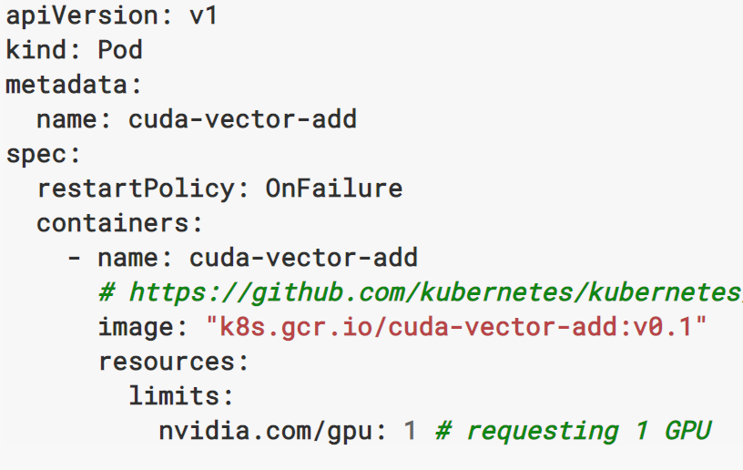
Deploying GPU Workloads onto OpenShift
Pod
Deployment
Job
Supported in OpenShift 3.11 (except Priority Class Quotas) and OpenShift 4.1 (RHEL7 only on GPU nodes)

Slide 38
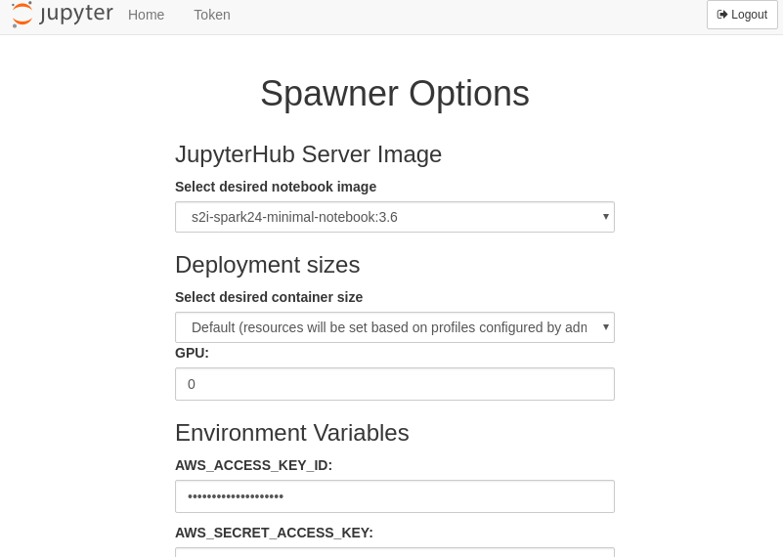
Using GPUs in Jupyter
Select number of GPUs to use via UI
Supported in OpenShift 3.11 (except Priority Class Quotas) and OpenShift 4.1 (RHEL7 only on GPU nodes)

Slide 39
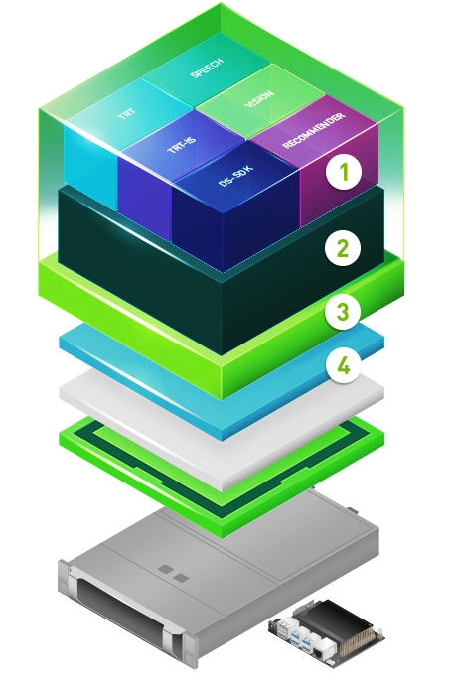
NVIDIA + Red Hat Joint Collaboration
NGC Containers
Kubernetes
Automation and autoscaling
CUDA Drivers for RHEL and RHEL CoreOS (RHCOS)
Also, joint development of support for HPC:
GPUDirect RDMA - direct I/O between GPU and 3rd party peer devices
SR/IOV and InfiniBand - sharing of single PCIe devices by multiple VM

Slide 40

Accelerated AI EAP - Partnership with NVIDIA
Objective: Drive mainstream adoption of AI across teams
General Enablement Work - RHEL, OpenShift GPU Enablement
DGX line, OEMs, Cloud Providers
OpenShift 4 Pilot - Accelerated AI EAP
OpenShift 4 on Bare-metal HW with NVIDIA GPUs
NVIDIA NGC Containers (AI/ML libraries CUDA optimized)
Request form: https://www.openshift.com/accelerated-ai
Summit Keynote Demo: https://youtu.be/FUu4kMc0PL8?t=1448
Offering Blog: https://blogs.nvidia.com/blog/2019/05/09/red-hat-openshift-gpu-kubernetes/
Technical Overview: https://devblogs.nvidia.com/gpu-support-ai-workloads-openshift4/
Documentation: https://docs.nvidia.com/datacenter/kubernetes/openshift-on-gpu-install-guide/index.html
Notes:
Red Hat Open Hybrid Cloud as THE PLATFORM for customers AI/ML initiatives

Slide 41
AI/ML Software Partners

Slide 42
Software Vendor Partner Program
Mission: With partners, make best-in-class AI/ML hybrid/multi-cloud ready for mainstream and enterprise markets
Primary Focus on OpenShift - kubernetes-powered multi/hybrid-cloud AI/ML platform
Hardware Ecosystem for Performance - GPUs
SW Ecosystem Enablement
Projects w/ Vendor Support - Certified vendors w/ commercial support
Balance Platforms & Components - Provide choice
Cloud-Like Experience - Operators, operatorhub.io, embedded operatorhub
Certifications with Red Hat Partner Connect (for Container and Operator certifications)
Via:
AI Reference Architecture - Open Data Hub - RH Ref Arch for AI for upstream/products/partners
AI Use Case Definitions - define core use cases - RH + Partners Enable these use cases

Slide 43

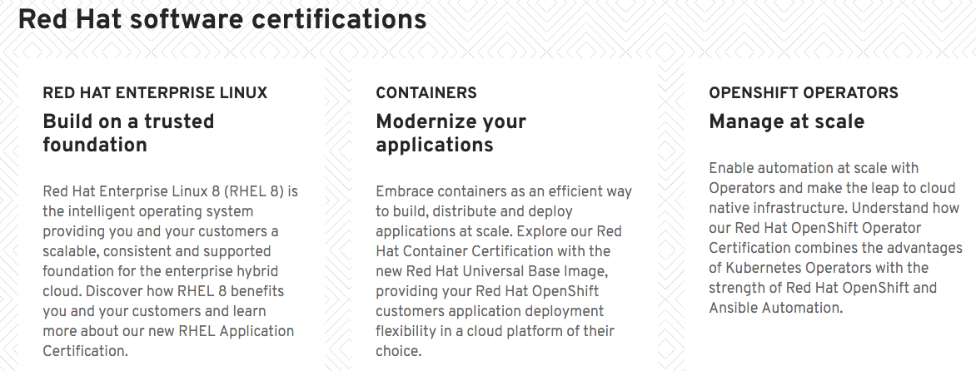
https://connect.redhat.com/

Slide 44
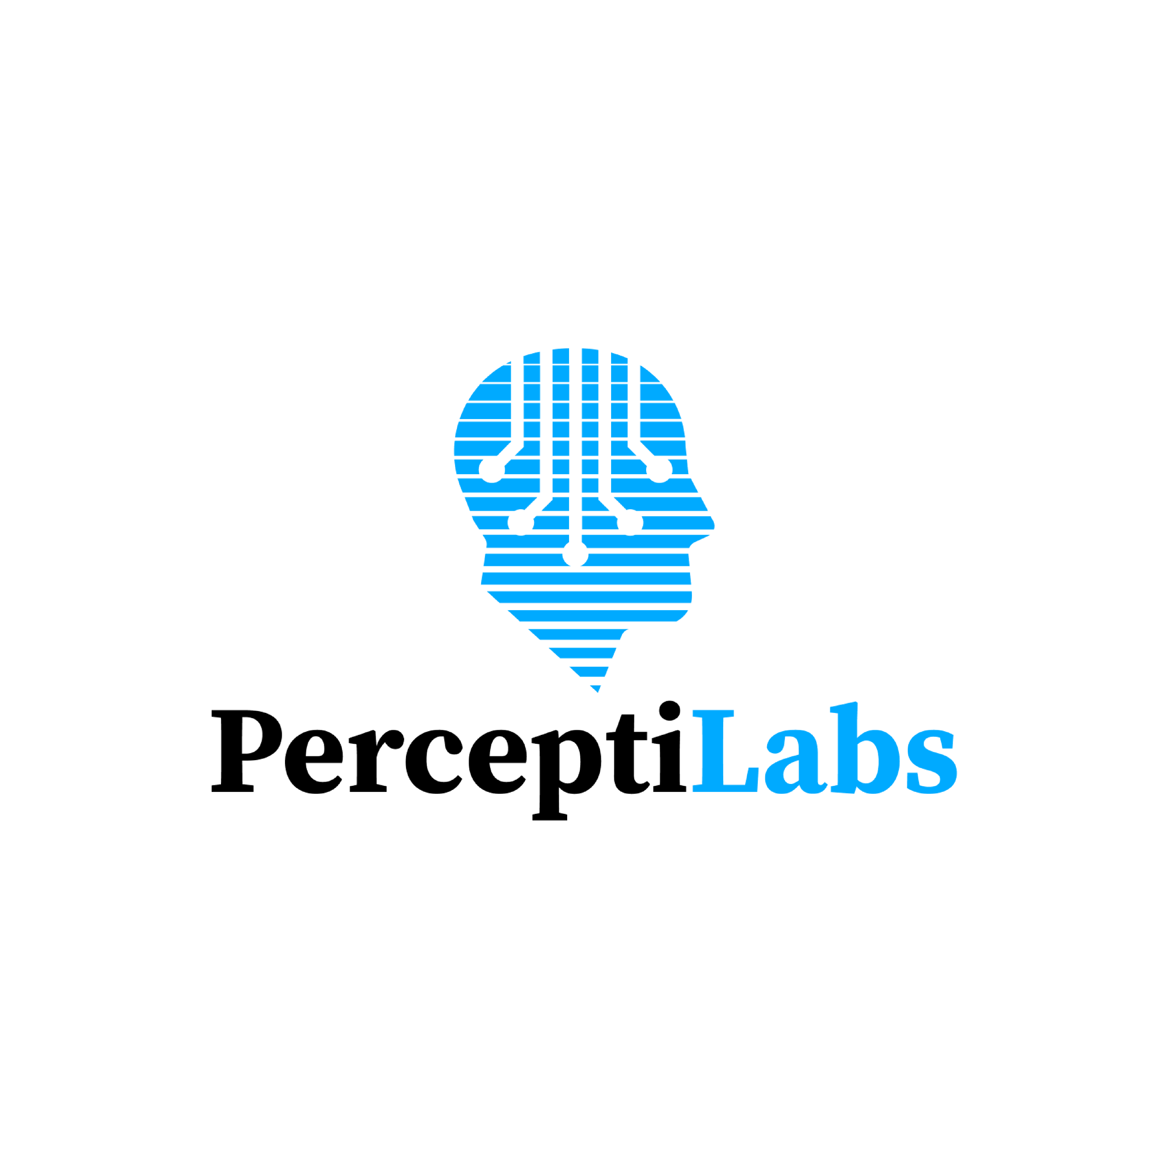


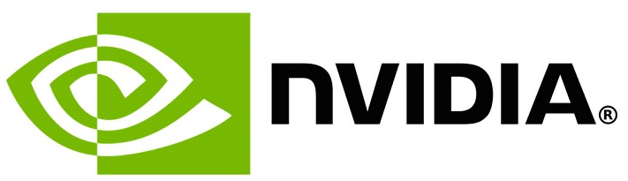









Who Are We Working With Today?
AI & advanced analytics platform
Integrated data and AI platform
Accelerated AI GPU & NGC
Deploy ML models and experiments at scale
Simplify building complex AI/ML models
Driverless.ai - Everyone can develop trusted ML models
Bring business experts deeper into the development of a cognitive business process
NoSQL database
AIOps for OpenShift
Apache NiFi
Open source SQL Engine
AI enablement platform for teams at scale
Explore & analyze data

Slide 45
THE LAB - LOGISTICS
1. WIFI for labs:
SSID: <enter>
Password: <enter>
2. This presentation: <enter>
Full URL: <enter>
3. Get a attendee number for the lab:
<enter instructions here>
4. Address for OpenShift web console: <enter>
Full URL: <enter>
Login to OpenShift web console
Username: user<number>
Password: <enter>
Instructions:
https://tinyurl.com/y3m2wrtz
Or full URL
https://gitlab.com/opendatahub/data-engineering-and-machine-learning-workshop/blob/master/doc/for-attendees.md

Slide 46

Thank you
OpenDataHub.io

